Slide 1

Welcome to Priory Surgery
Tel: 0117 949 3988
www.priorysurgerybristol.co.uk

Slide 2

In June 2026
We provided
4693
appointments

Slide 3
Breakdown of appointments offered
GP’s/Trainee doctors and student doctors – 2651
Nursing/Chronic Illness reviews – 1441
ANP - 250

Slide 4
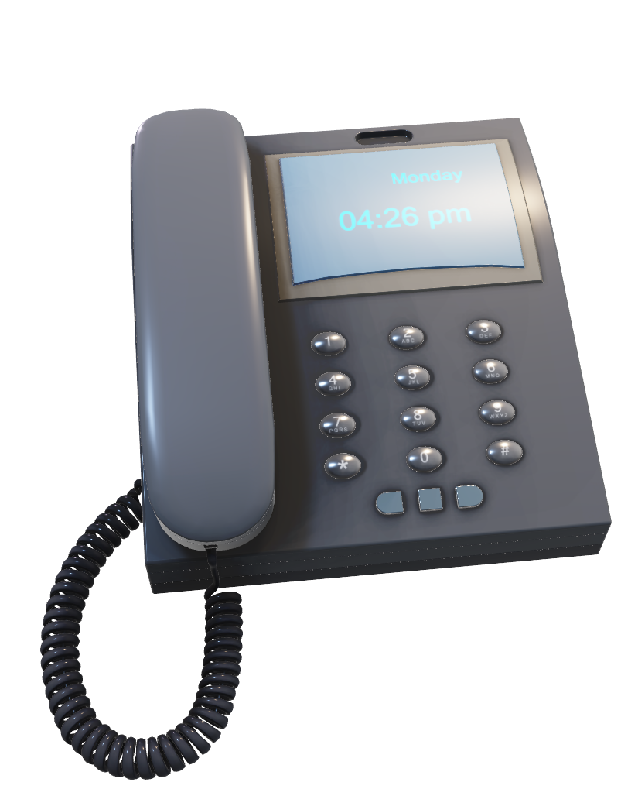
In June 2026
We handled
4428
Telephone calls

Slide 5
Call Figures from June 2026
We took 4428 telephone calls
Average Queue Time Answered – 6m 8s
Opted for a call back – 565
Call backs successful – 516
Call backs unsuccessful – 26
Call backs cancelled - 23

Slide 6
We offered PCN Appointments
Physio – 86
Mental Health and Wellbeing coach – 93
Social Prescriber – 103
Pharmacist - 221

Slide 7
In June 2026
112
Patients did not attend their booked appointments

Slide 8
DNA’s for June 2026
GP’s – 42
ANP’s – 7
Nursing staff – 53
PCN – 9
Bristol Drug Project - 1

Slide 9
Impact of Missed Appointments
Demand for appointments is very high, and whilst we are aware that there are some circumstances which can make a missed appointment inevitable, their impact can be significant, leading to:
  An overall increase in waiting times
  Frustration for both staff and patients
  A waste of resources
  A potential risk to the health of other patients because of the above
We would therefore politely request patients to contact the surgery and let us know, if you are unable to attend your appointment.

Slide 10

Tel: 0117 949 3988
www.priorysurgerybristol.co.uk

